Slide 1

GIT AND GIT HUB

Slide 2
General Guideline
© (2024) ABES Engineering College.
This document contains valuable confidential and proprietary information of ABESEC. Such confidential and proprietary information includes, amongst others, proprietary intellectual property which can be legally protected and commercialized. Such information is furnished herein for training purposes only. Except with the express prior written permission of ABESEC, this document and the information contained herein may not be published, disclosed, or used for any other purpose.

Slide 3
Table of Content
Git Introduction
Git Hub Introduction
Git Setup
Git Branching
Git Stashing
Git Merging

Slide 4
About Git
git is a distributed version control system
https://git-scm.com
git was developed by the linux community in 2005 to help manage the
development of linux itself
On Mac OS X: first install homebrew: Details at http://brew.sh
Git is foundation of many services like GitHub and GitLab, but we can use Git without using any other Git services.
Git can be used privately and publicly

Slide 5
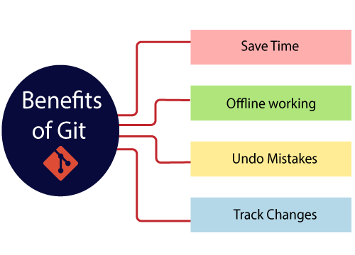
Benefits of Git

Slide 6
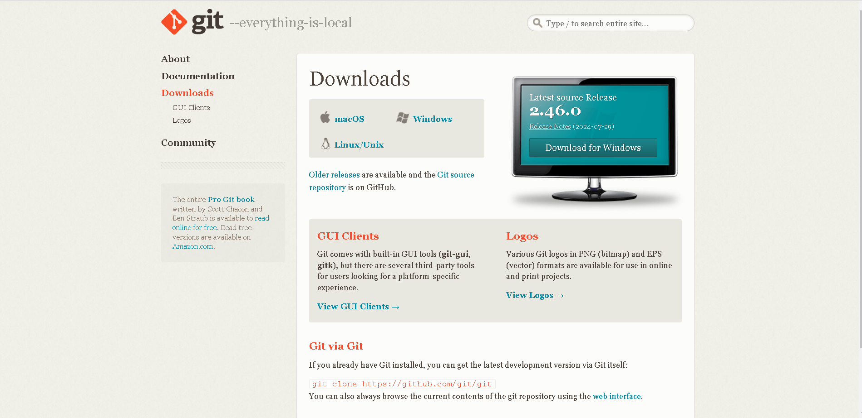
Download Git

Slide 7
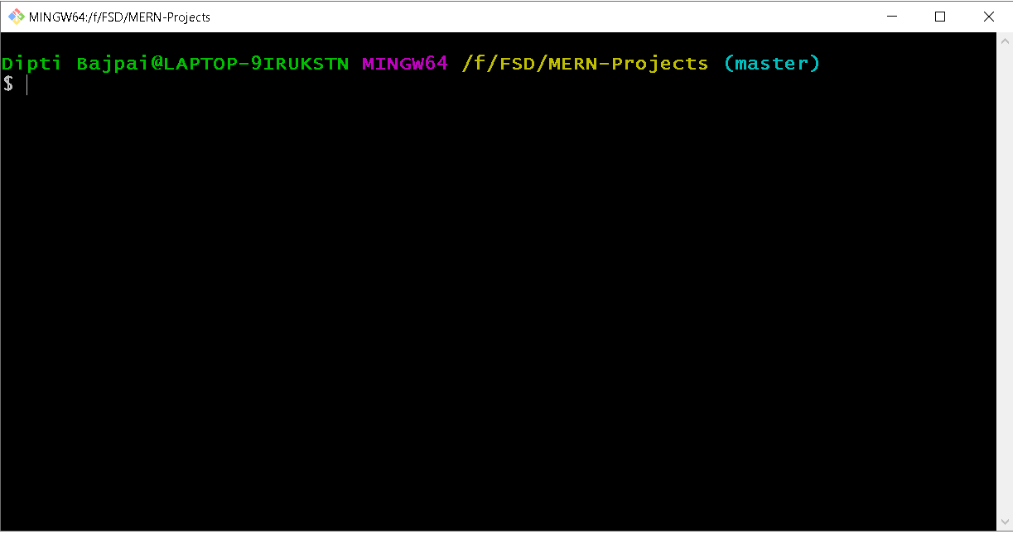
Git bash

Slide 8
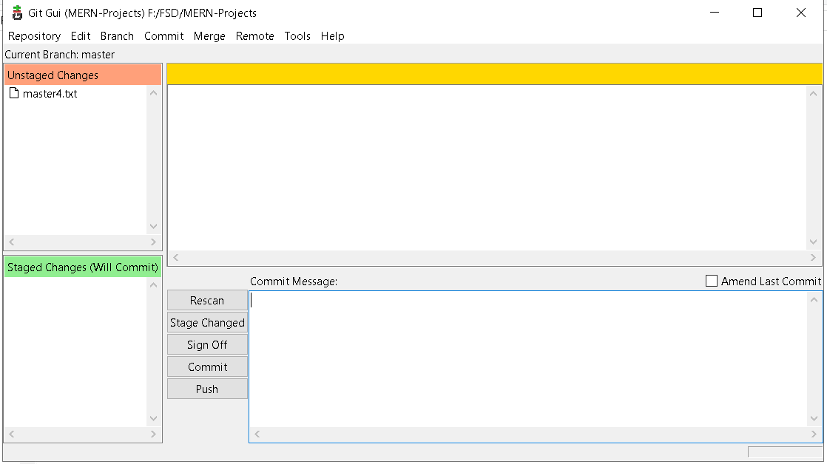
Git gui

Slide 9
Git Hub
GitHub is a Git repository hosting service.
It offers both distributed version control and source code management (SCM) functionality of Git.
GitHub also facilitates with many of its features, such as access control and collaboration.
It provides a Web-based graphical interface.

Slide 10
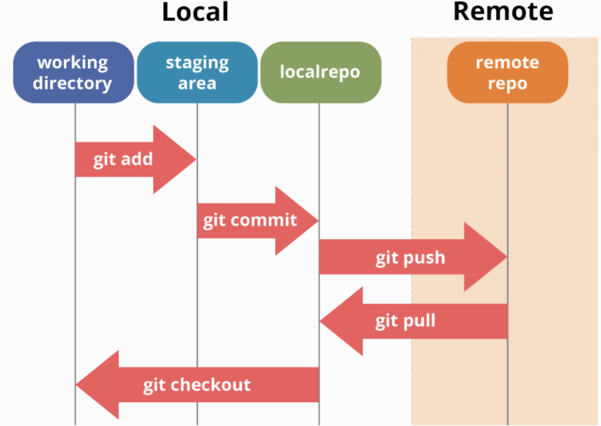
How git works

Slide 11
Git Hub Features
Collaboration
Integrated issue and bug tracking
Graphical representation of branches
Git repositories hosting
Project management
Team management
Code hosting
Track and assign tasks

Slide 12
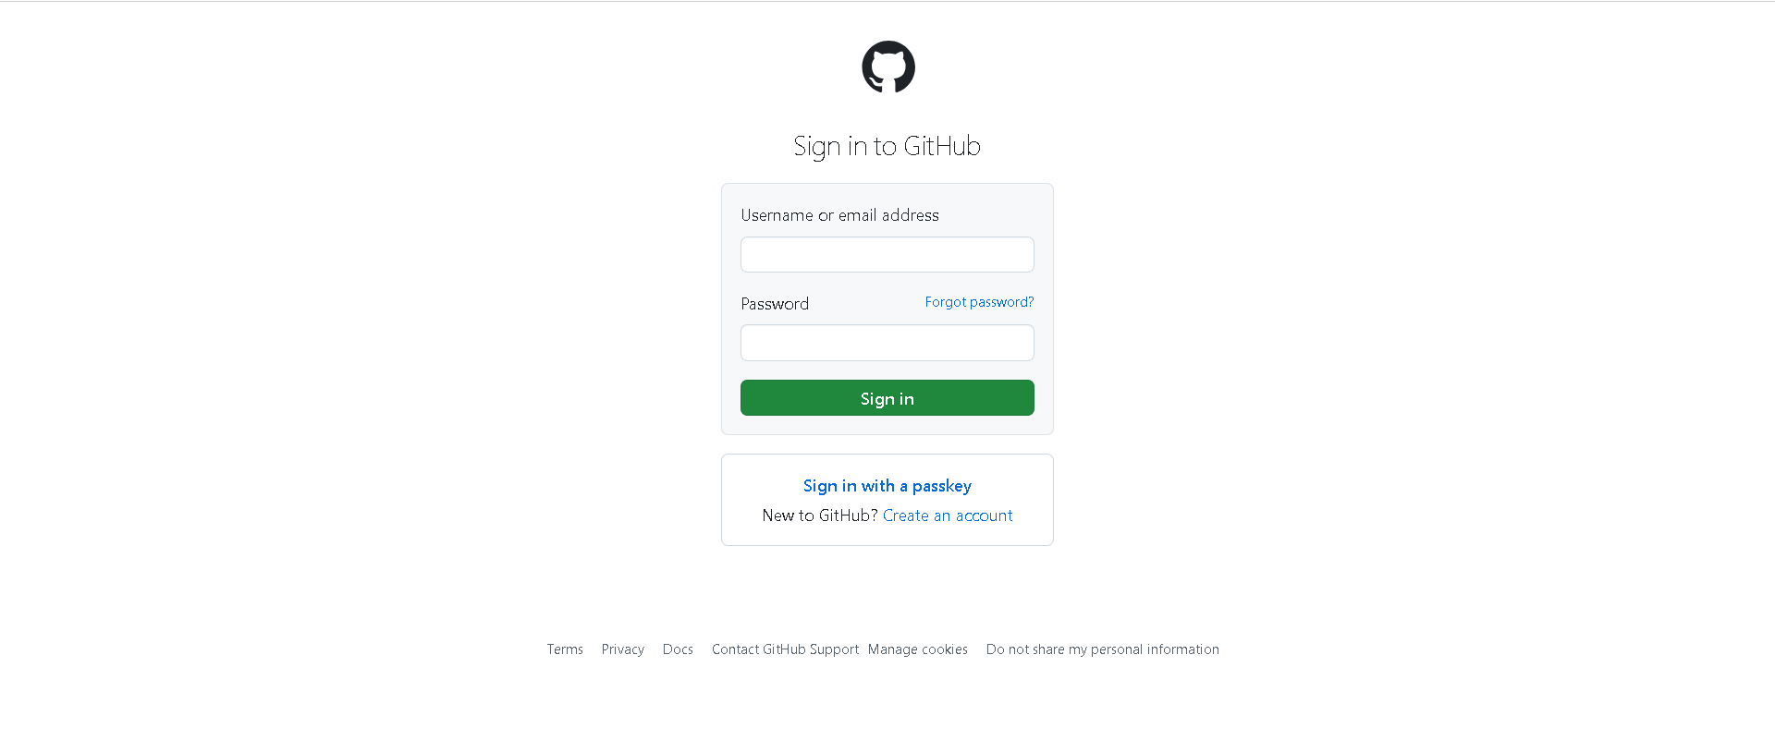
Git Hub

Slide 13
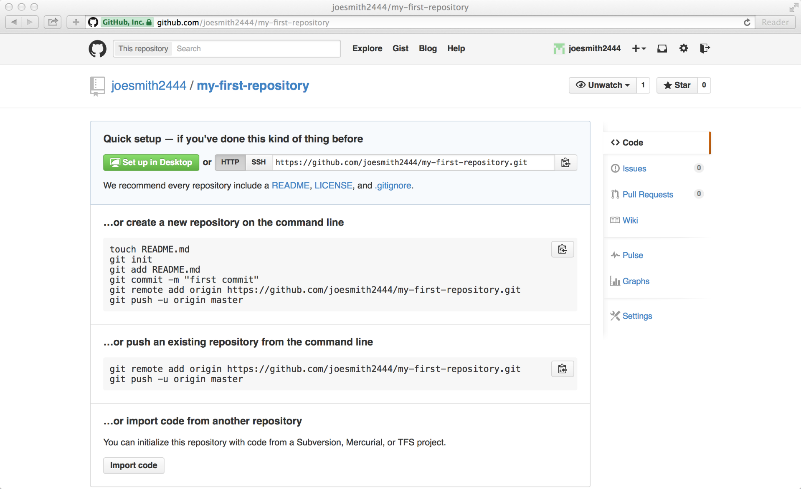
Git Hub Repositories

Slide 14
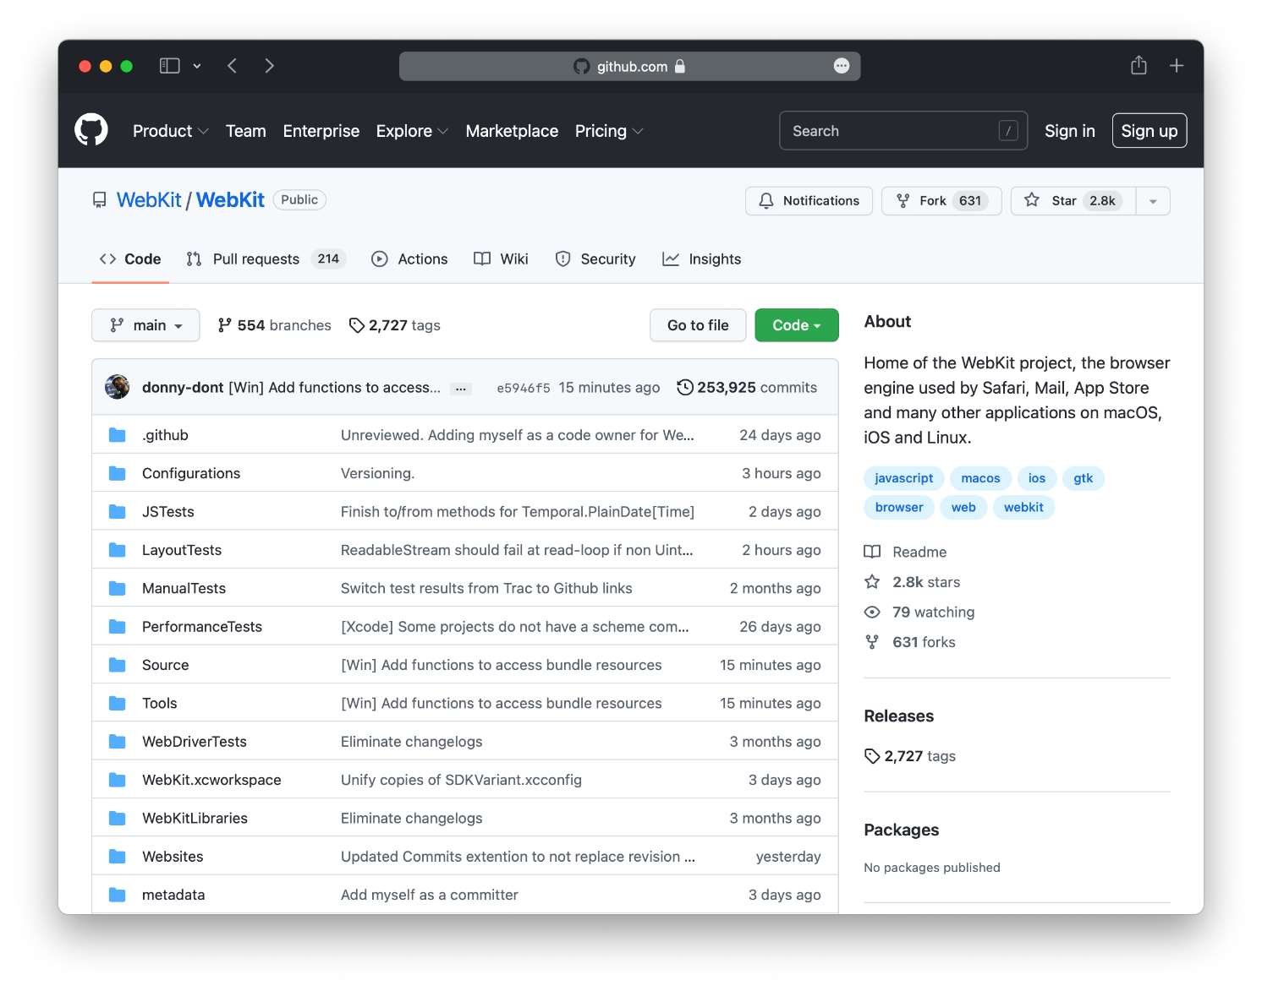
Repository files

Slide 15
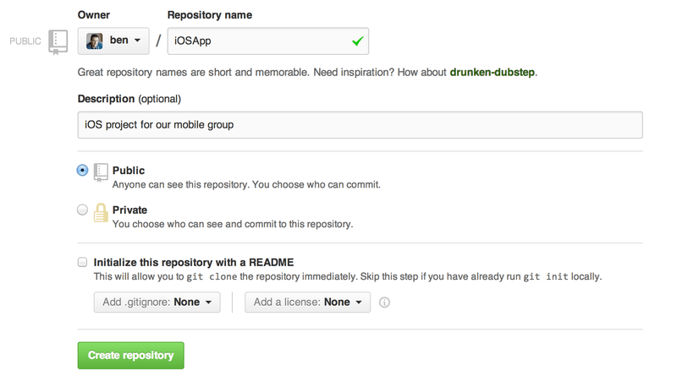
Public and Private Repository

Slide 16
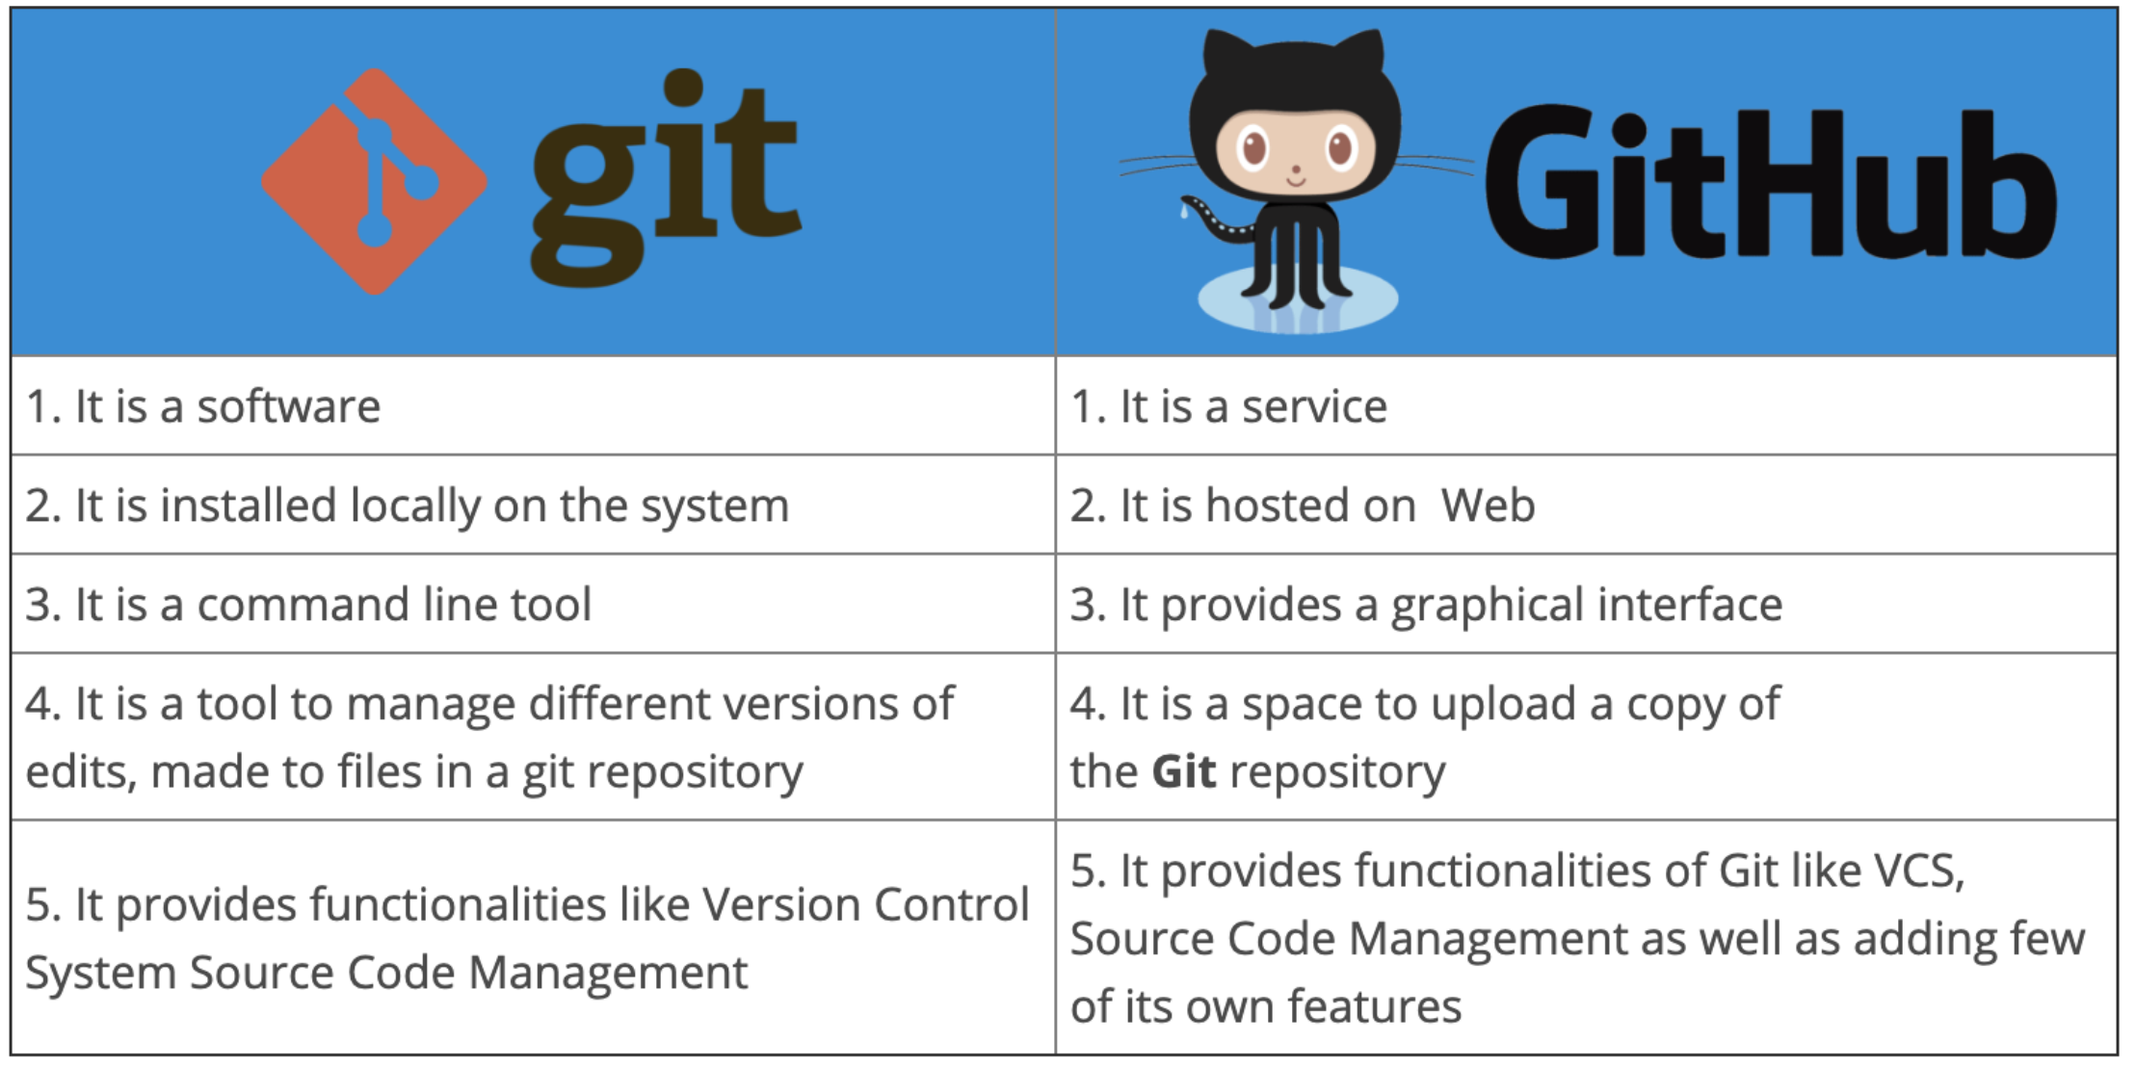
Git vs GitHub

Slide 17
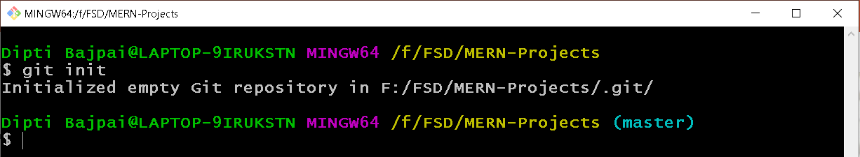
Git Initialized

Slide 18
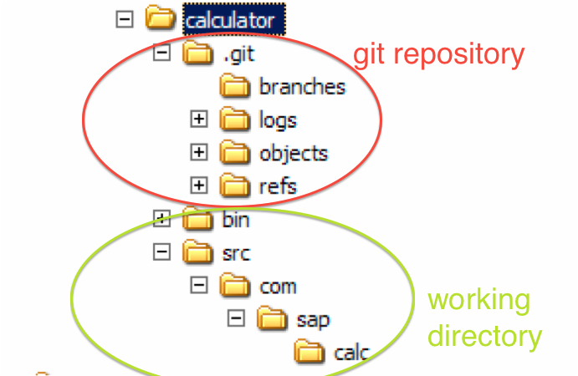
Git Concept: Storage

Slide 19
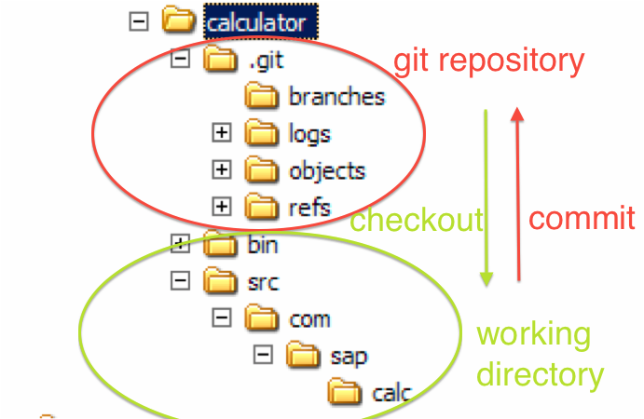
Git Concept: Storage

Slide 20
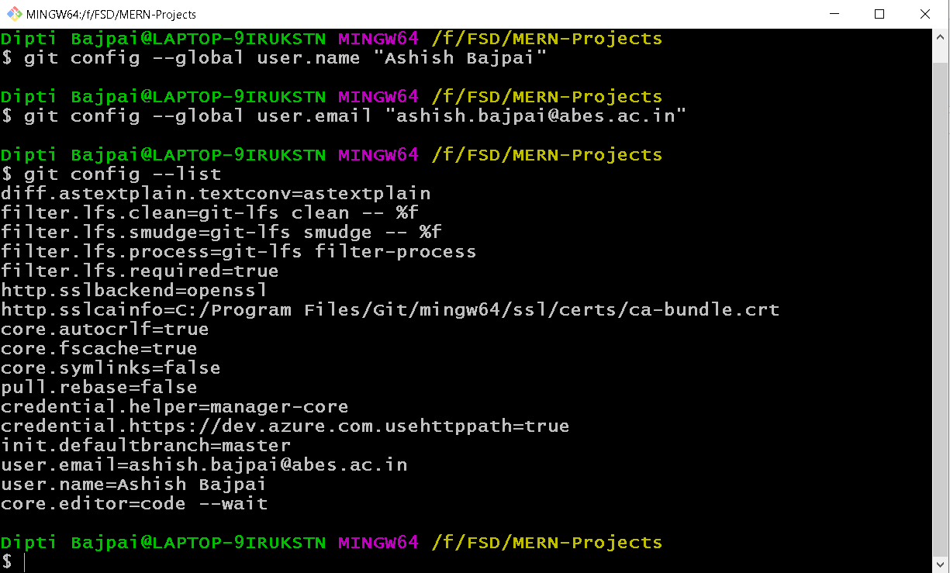
Git Setup

Slide 21
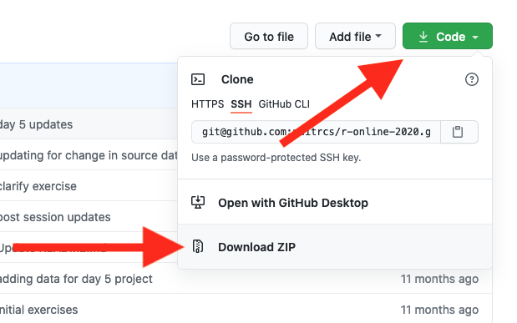
Push to GitHub

Slide 22
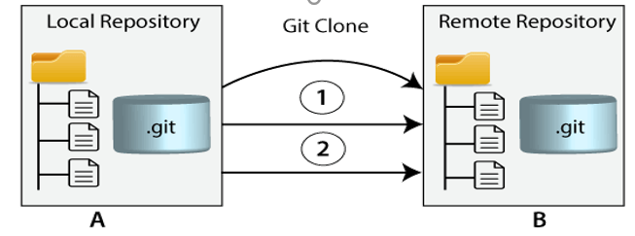
Git Push and Git Pull
Git push origin <branch_name>
Git pull origin <branch_name>

Slide 23
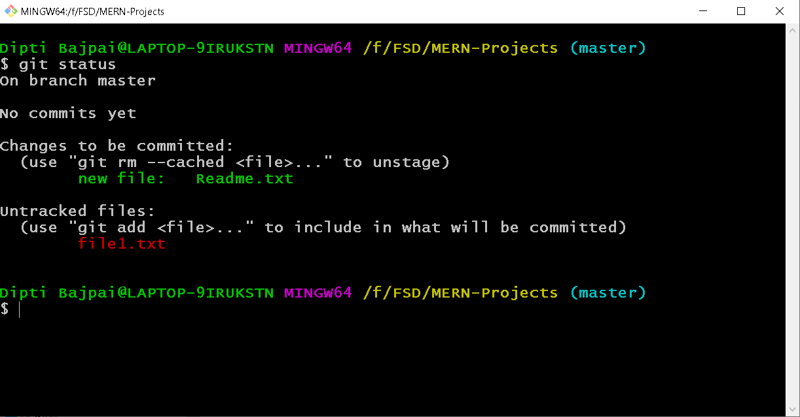
Git Status

Slide 24
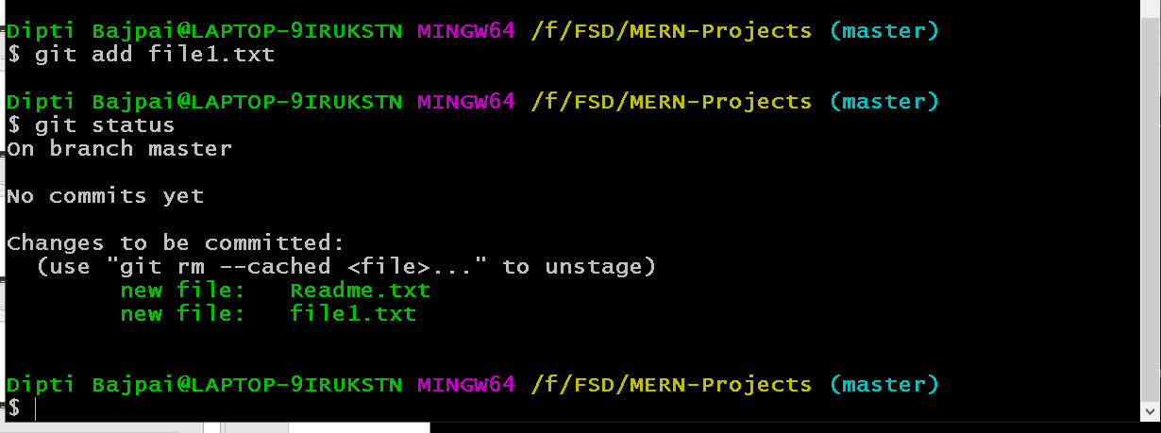
Add file from work are to staging area

Slide 25
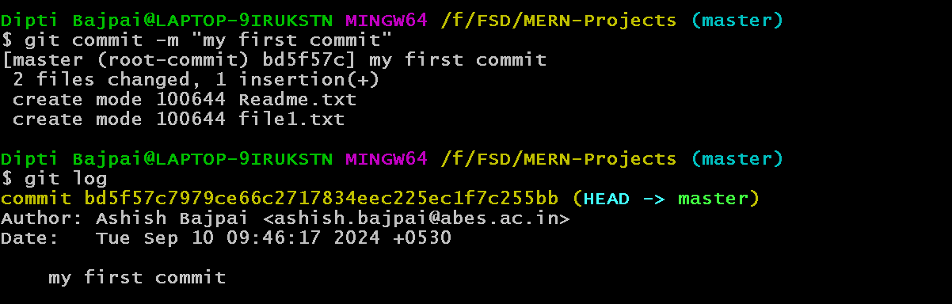
Git commit and log

Slide 26
Git Branching
View branch list
git branch
Create New Branch
git branch <new_branch_name>
Switch Branch
git checkout <old_branch_name>
Create a Branch and Switch to it
git checkout –b <new_branch_name>
Delete Branch
git branch –d <branch_name>( if it has already been fully merged in its upstream branch)
git branch –D <branch_name>

Slide 27
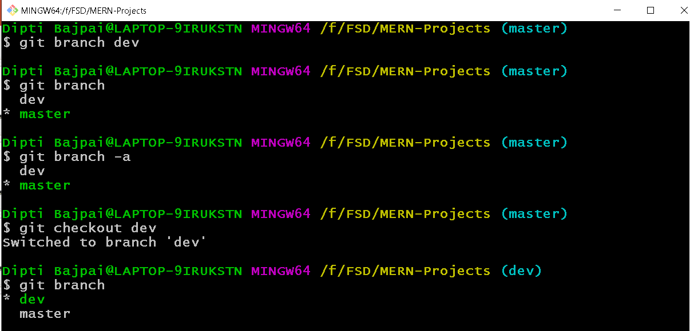
Git Branching(cont …)

Slide 28
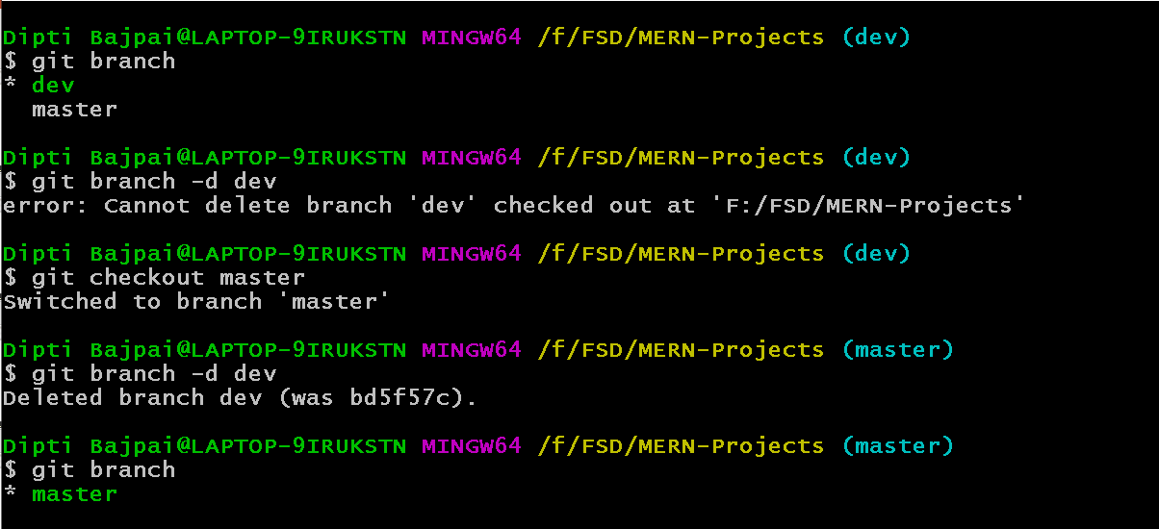
Delete branch

Slide 29

Git merging
Git merge <branch_name>

Slide 30
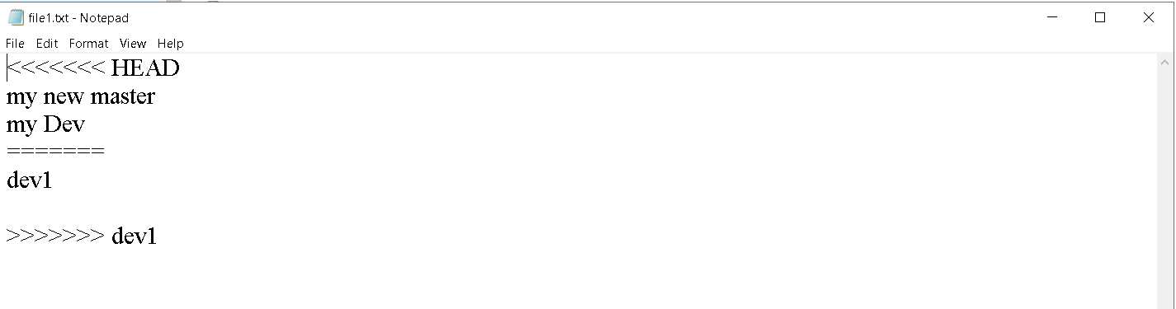
Conflict

Slide 31

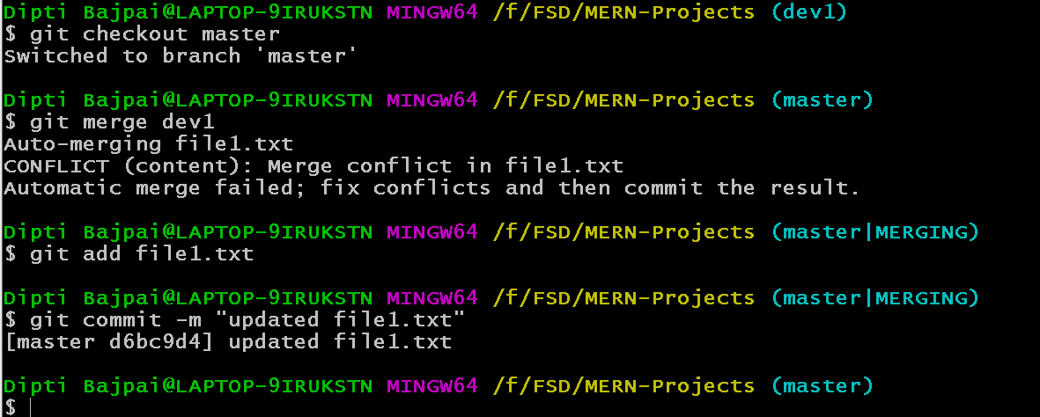
Resolve conflict manually

Slide 32
Git Stashing
git stash
git stash list
git stash pop
git stash apply stash@{n}

Slide 33
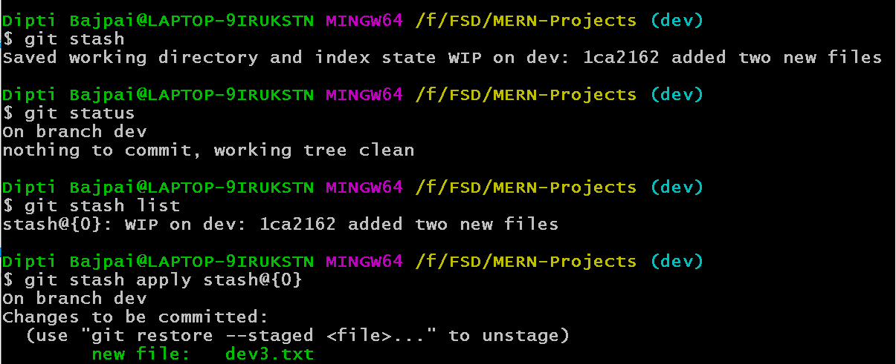

Slide 34
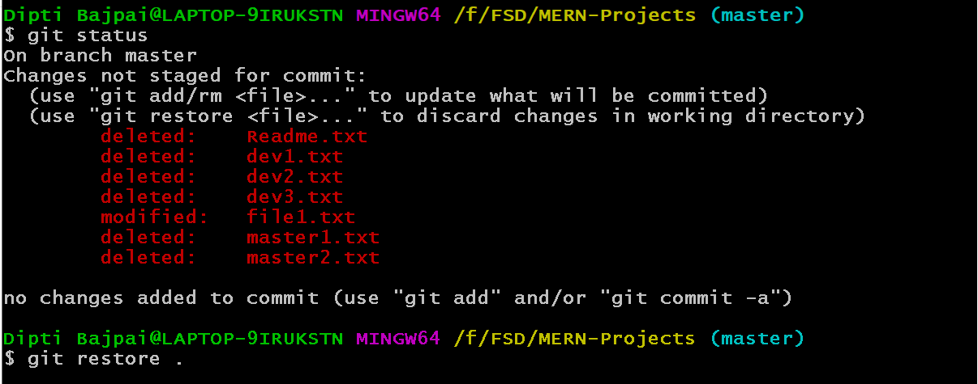
Discard changes in working directory

Slide 35
Reference
Amazon Web Service (https://aws.amazon.com/)

Slide 36
Thank You

